Slide 1
CPU Scheduling Algorithm Results

Slide 2
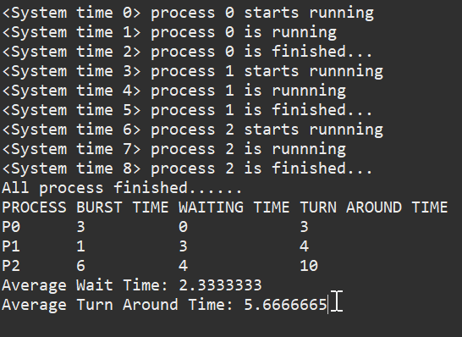
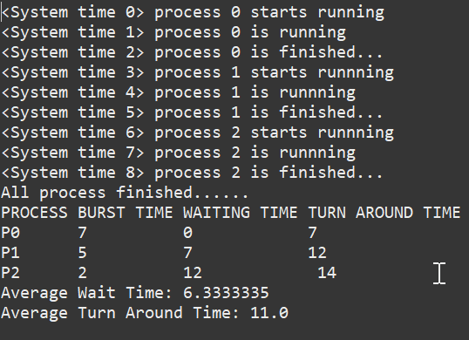
First Come First Serve (Results)
Test #1
Test #2
PID | Arrival Time | Burst Time
0 | 2 | 3
1 | 5 | 1
2 | 4 | 6
PID | Arrival Time | Burst Time
0 | 8 | 7
1 | 3 | 5
2 | 5 | 2

Slide 3
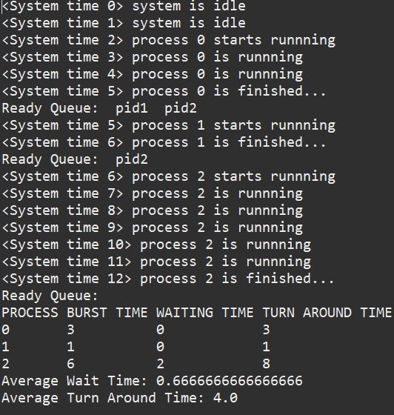
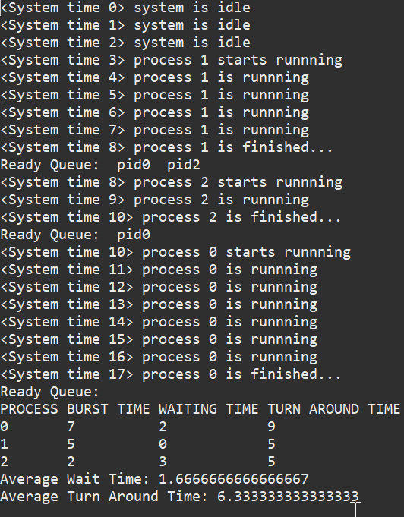
Shortest Job First (Results)
Test #1
Test #2
PID | Arrival Time | Burst Time
0 | 2 | 3
1 | 5 | 1
2 | 4 | 6
PID | Arrival Time | Burst Time
0 | 8 | 7
1 | 3 | 5
2 | 5 | 2

Slide 4
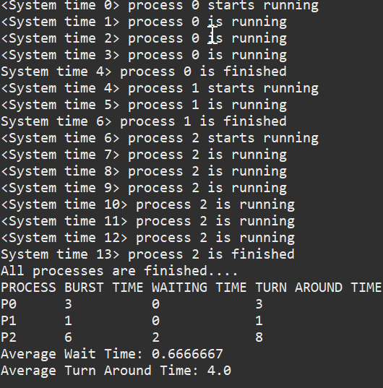
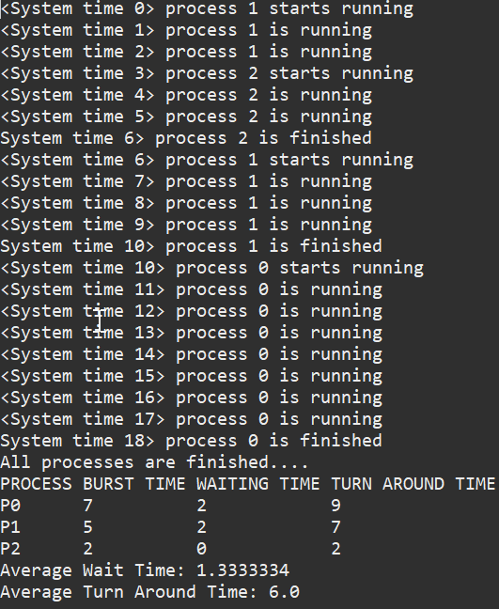
Shortest Remaining Time First (Results)
Test #1
Test #2
PID | Arrival Time | Burst Time
0 | 2 | 3
1 | 5 | 1
2 | 4 | 6
PID | Arrival Time | Burst Time
0 | 8 | 7
1 | 3 | 5
2 | 5 | 2

Slide 5
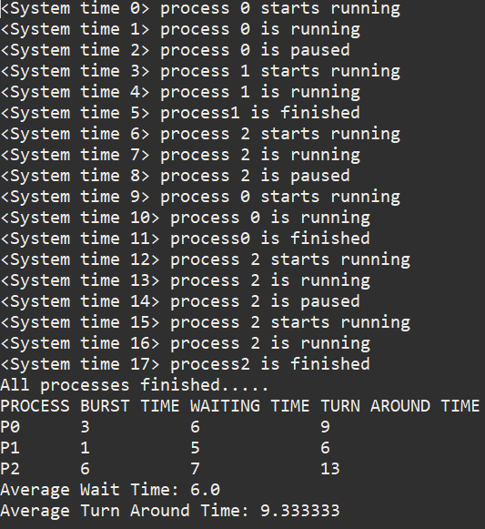
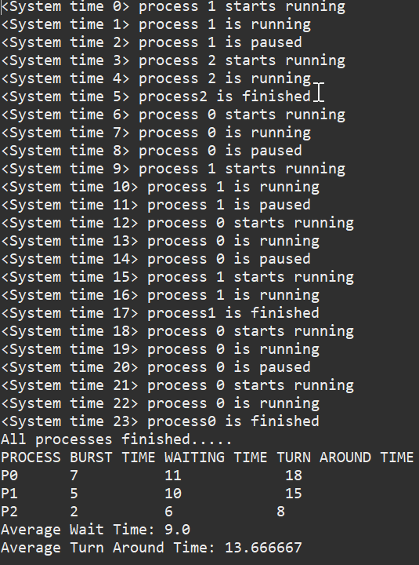
Round Robin(Results)
Test #1
Test #2
PID | Arrival Time | Burst Time
0 | 2 | 3
1 | 5 | 1
2 | 4 | 6
PID | Arrival Time | Burst Time
0 | 8 | 7
1 | 3 | 5
2 | 5 | 2

Slide 6
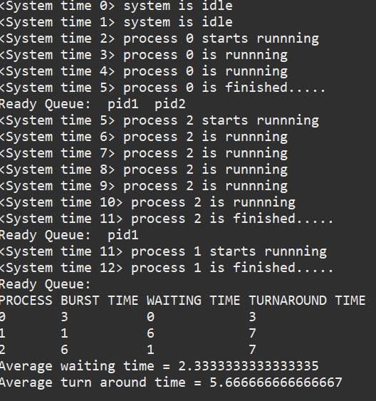
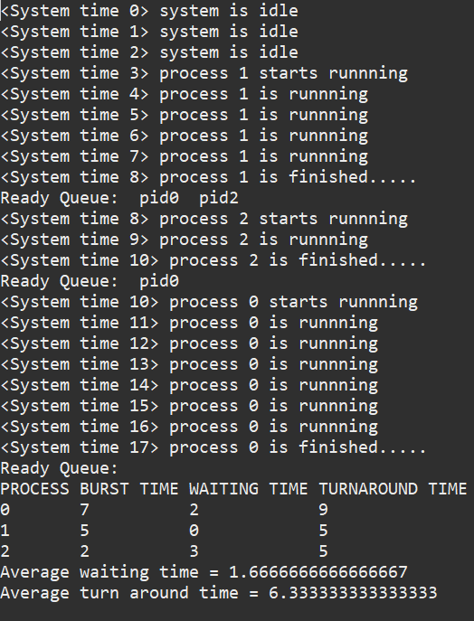
High Response Ration Next(Results)
Test #1
Test #2
PID | Arrival Time | Burst Time
0 | 2 | 3
1 | 5 | 1
2 | 4 | 6
PID | Arrival Time | Burst Time
0 | 8 | 7
1 | 3 | 5
2 | 5 | 2

Slide 7
These tests are the instances we tested on every Scheduling Algorithm:
Test #1
Test #2
Test #3
PID | Arrival Time | Burst Time
0 | 2 | 3
1 | 5 | 1
2 | 4 | 6
PID | Arrival Time | Burst Time
0 | 8 | 7
1 | 3 | 5
2 | 5 | 2
PID | Arrival Time | Burst Time
0 | 0 | 4
1 | 0 | 6
2 | 0 | 8
Test #4
Test #5
PID | Arrival Time | Burst Time
0 | 3 | 6
1 | 1 | 15
2 | 2 | 17
3 | 4 | 3
4 | 5 | 1
PID | Arrival Time | Burst Time
0 | 2 | 60
1 | 5 | 10
2 | 3 | 20
3 | 1 | 5
4 | 4 | 25

Slide 8
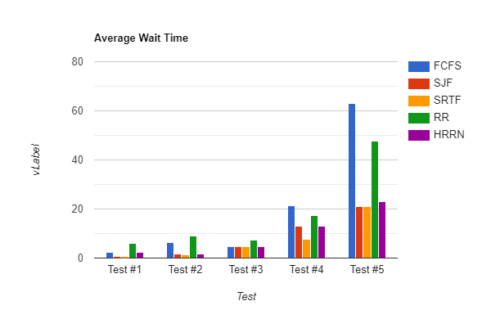
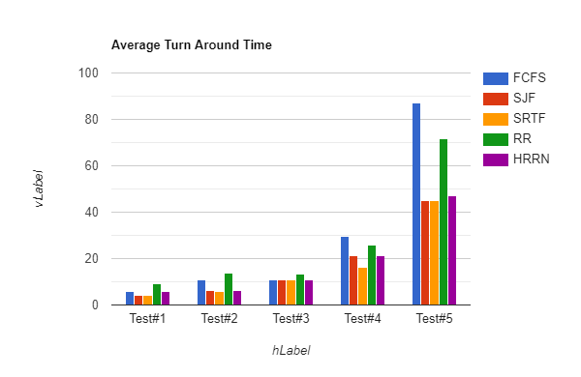
Comparison/ Conclusion
FCFS is the easiest to implement but least efficient in wait time and turn around time.
RR is a little better than FCFS, but it still has a bad wait time and turn around time compared to SJF, SRTF, AND HRRN.
HRRN is not far behind SJF and SRTF in wait time and turn around time.
SJF and SRTF are generally the best in avg wait time and turn around time.

